Slide 1
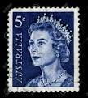
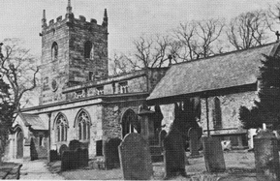
England
The Great Plague started in London and reached to Eyam through a shipment of cloth carrying the plague bacterium.
The story of Eyam is nothing short of a truly heroic one. In 1665, he Great Plague spread from London to Eyam through a parcel that contained some of the fleas causing the plague. Even though the primary instinct of the villagers was to get out of the village, they decided to quarantine themselves in order to prevent its transmission into other cities. By the end of 1666, 260 out of 350 people had died.
http://www.historylearningsite.co.uk/stuart-england/eyam-and-the-great-plague-of-1665/

Slide 2

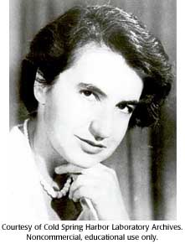
England
Rosalind Franklin worked in J.T. Randell's lab in King’s College in 1951.
This was where Franklin met Maurice Wilkins, who secretly shared Franklin’s high-resolution photos of crystallized DNA with Watson and Crick. These photos proved to Watson and Crick that DNA is, in fact, a double-helix. Unfortunately, she could not receive the Nobel Prize that was given to Watson, Crick, and Wilkins since she had died of cancer 4 years prior.
http://www.dnaftb.org/19/bio-3.html

Slide 3
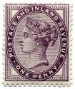
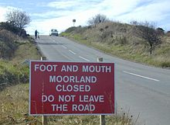
England
Nearly 4 million hoofed animals infected with or exposed to foot-and-mouth disease in England in 2001 were incinerated and buried.
More than 10 million sheep and cattle were killed by owners, in order to stop the progression of the outbreak. Sales of these animals were also banned until the disease was said to be eradicated. These extensive measures led to a halt of the disease around 2002.
https://en.wikipedia.org/wiki/2001_United_Kingdom_foot-and-mouth_outbreak

Slide 4
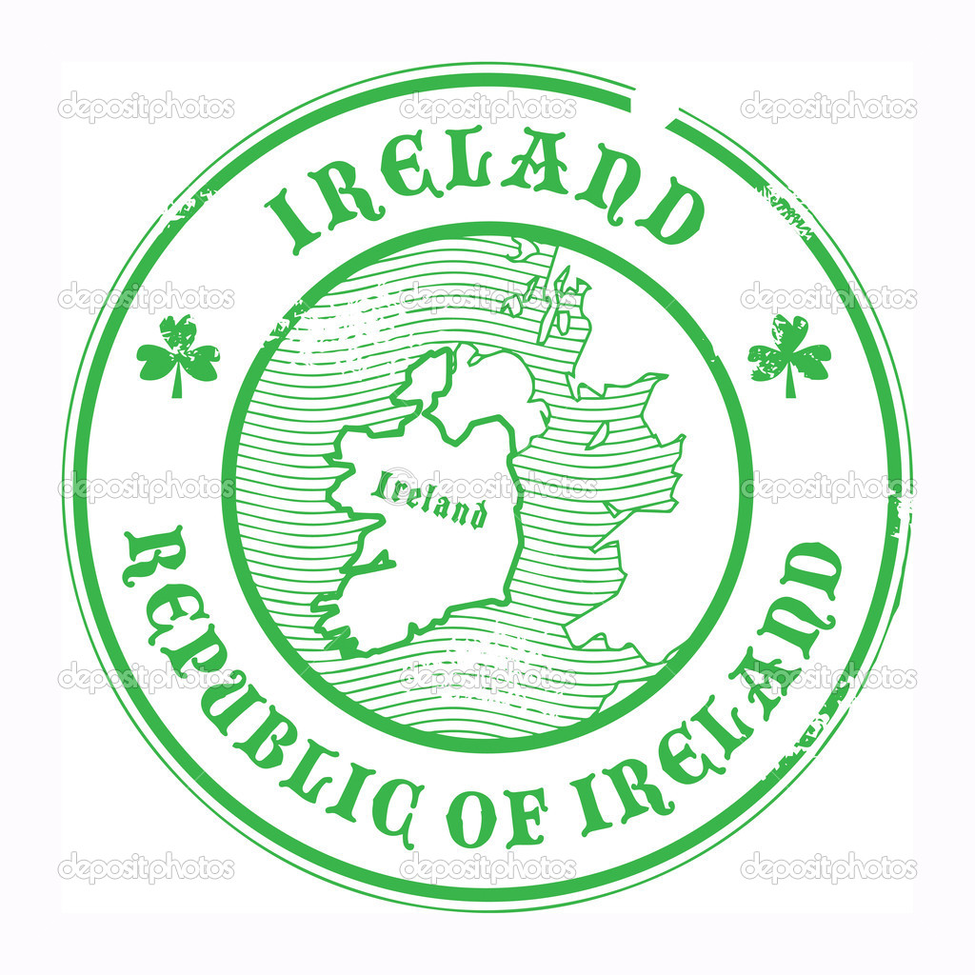
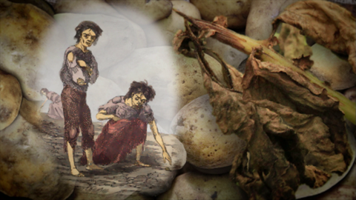
Ireland
Almost all potato crops were destroyed because of Phytophthora infestans causing late blight of potatoes.
Over 1 million Irish people died of starvation and many more left the country. Ireland was vulnerable to famine since they relied heavily on just one or two high-yielding types of potato, which greatly reduced the genetic variety that ordinarily prevents the decimation of an entire crop by disease.
http://www.britannica.com/event/Great-Famine-Irish-history

Slide 5

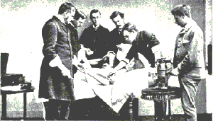
Scotland
In 1865, Joseph Lister used carbolic acid spray in surgery to prevent infection.
Pasteur had used heat and filters to eliminate the germs in the wine, but these techniques were not suitable for use with human flesh. Instead, Lister needed to find a suitable chemical to kill the germs. Lister used carbolic acid to wash his hands, his instruments, and the bandages used in the operation. He published his findings in the medical journal, The Lancet, in 1867.
https://answersingenesis.org/creation-scientists/joseph-lister-father-of-modern-surgery/

Slide 6

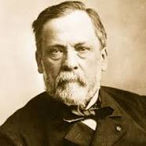
France
Louis Pasteur was born here in 1822. He found the "germ theory of disease".
The germ theory of disease states that some diseases are caused by microorganisms. These small organisms, too small to see without magnification, invade humans, animals, and other living hosts. Their growth and reproduction within their hosts can cause a disease.
https://en.wikipedia.org/wiki/Germ_theory_of_disease

Slide 7
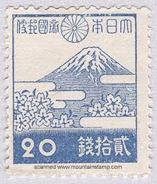

Japan
Masaki Ogata was born here in 1964. He reported that rat fleas transmit bubonic plague, thereby solving the centuries old mystery of how plague spread.
Bubonic plague is one of three types of bacterial infection caused by Yersinia pestis. Three to seven days after exposure to the bacteria flu like symptoms develop. This includes fever, headaches, and vomiting. Swollen and painful lymph nodes occur in the area closest to where the bacteria entered the skin
https://en.wikipedia.org/wiki/Bubonic_plague

Slide 8
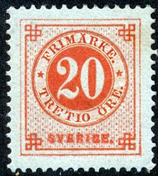
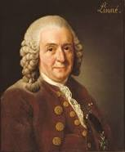
Sweden
Carolus Linnaelus was born here in 1701. He devised the formal two-part naming system we use to classify all lifeforms.
The classification of lifeforms is called taxonomy. Linnaeus classified living things by looking for similarities. For example he would look at the teeth of different mammals to decide if they were related. In modern times, DNA is used to classify lifeforms. In the case of fossils, where no DNA is present, scientists still use similarities between fossils – and between fossils and current lifeforms – to classify them.
http://www.famousscientists.org/carolus-linnaeus/

Slide 9

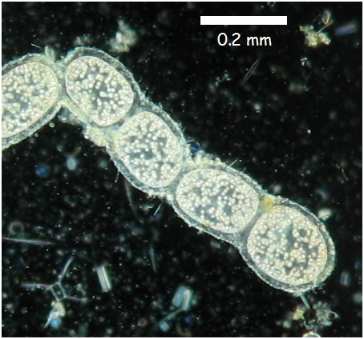
Germany
Scientists found Thiomargarita namibiensis in 1997.
It currently holds the world record for largest known bacterium (Schulz 2002). This microbe ranges from 100 to 300 micrometres in length with the largest reported to be 750 micrometres
https://microbewiki.kenyon.edu/index.php/Thiomargarita_namibiensis

Slide 10
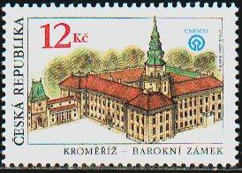
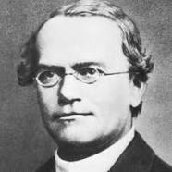
Czech Republic
Gregor Mendel was born here in 1853. He worked with pea plants and observed inheritance patterns.
The way in which traits are passed from one generation to the next-and sometimes skip generations-was first explained by Gregor Mendel. By experimenting with pea plant breeding, Mendel developed three principles of inheritance that described the transmission of genetic traits, before anyone knew genes existed.
http://www.nature.com/scitable/topicpage/gregor-mendel-and-the-principles-of-inheritance-593

Slide 11
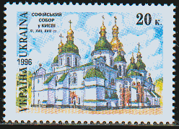
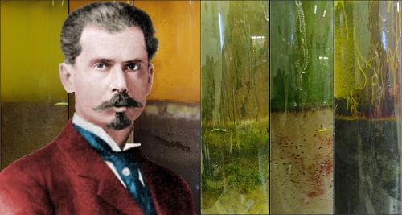
Ukraine
Segei Winogardsky was born here in 1856. He discovered how certain bacteria use CO2 to produce sugars. This process is considered chemosynthesis.
Many microorganisms in dark regions of the oceans also use chemosynthesis to produce biomass from single carbon molecules
https://en.wikipedia.org/wiki/Chemosynthesis

Slide 12
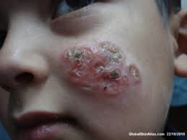
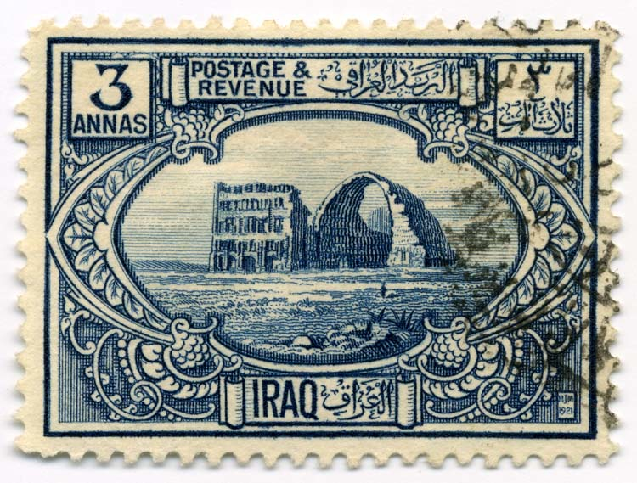
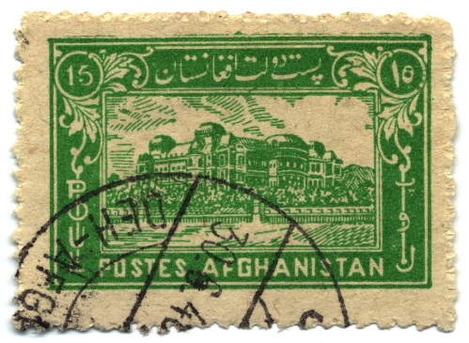
Afghanistan and Iraq
Leishmania major caused "Baghdad Boil" in US troops.
Scientists and doctors refer to the disease caused by the parasite as cutaneous leishmaniasis. The sores are not painful or contagious, but left untreated they can last up to 18 months and leave permanent, burn-like scars.
http://www.cbsnews.com/news/gis-battle-baghdad-boil/

Slide 13
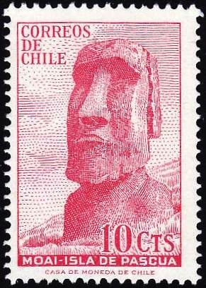
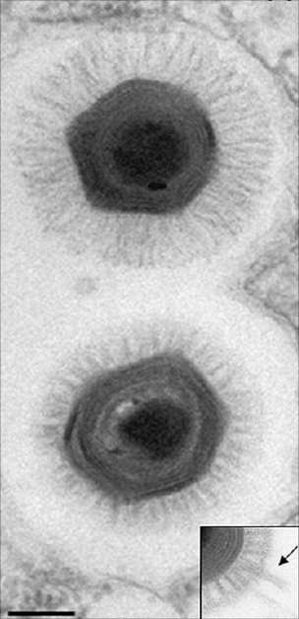
Chile
Biggest virus yet called Megavirus was discovered here.
Called Megavirus chilensis, it is 10 to 20 times wider than the average virus. It just beats the previous record holder, Mimivirus, which was found in a water cooling tower in the UK in 1992.
http://www.bbc.com/news/science-environment-15242386

Slide 14
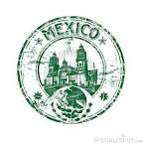
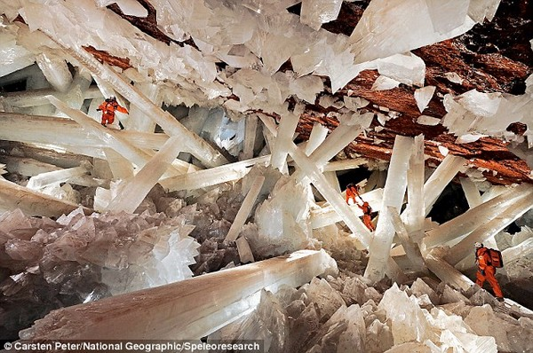
Mexico
The Cave of Crystals is 300 meters below the surface in Naica, Chihuahua, Mexico. It first seemed devoid of life but then scientists discovered around 200 viruses per drop of water.
The conditions here are extreme, with a constant temperature of 58 °C and high humidity, proving to be a dangerous environment for those who are exposed more than 10 minutes without proper equipment. The crystals are said to be 500,000 years old.
http://www.tourismontheedge.com/get-extreme/largest-crystals-in-the-world-giant-crystal-cave-mexico

Slide 15
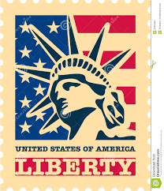
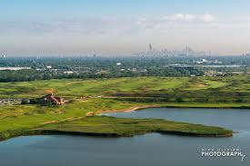
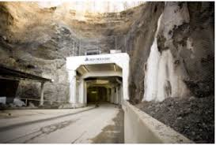
United States of America
Iron Mountain is the most acidic environment where microbes can exist, specifically Ferroplasma acidarmanus.
Lake Calumet is the most basic environment where microbes, specifically proteobacteria, can exist.

Slide 16
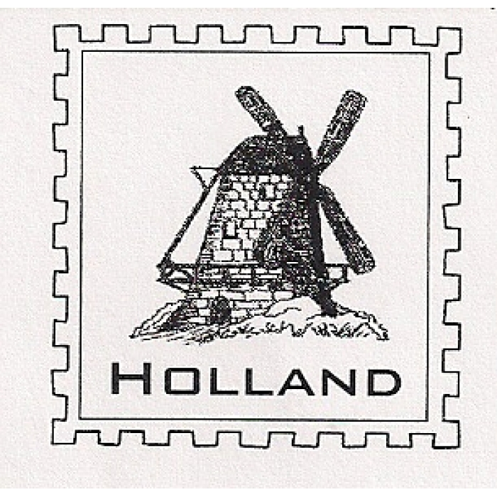
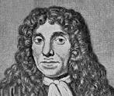
Holland
Antony van Leeuwenhoek found his "animalcules" in 1673.
Most of the "animalcules" are now referred to as unicellular organisms, though he observed multicellular organisms in pond water. He was also the first to document microscopic observations of muscle fibers, bacteria, spermatozoa, and blood flow in capillaries.
https://en.wikipedia.org/wiki/Antonie_van_Leeuwenhoek

Slide 17
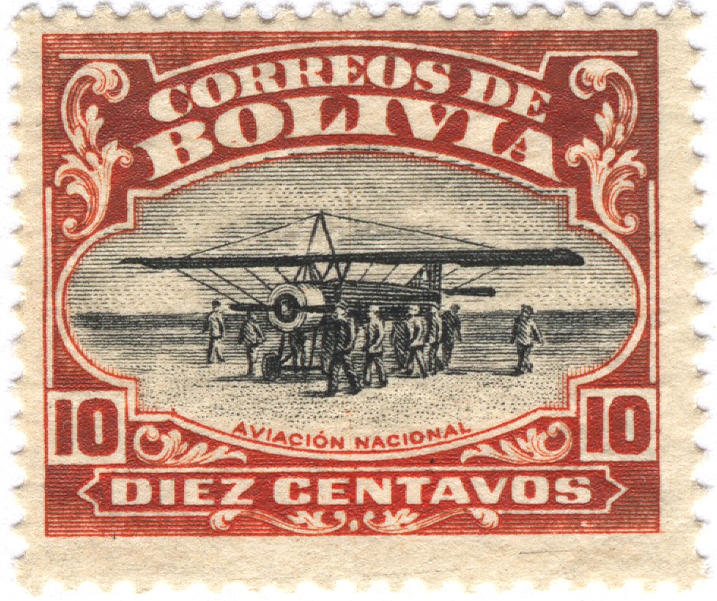
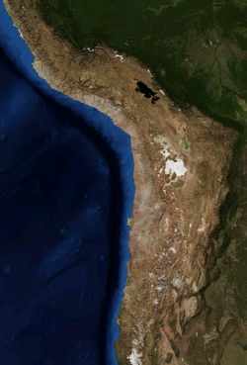
Bolivia
The Atacama Desert is one of the driest deserts on Earth and, as such, a natural laboratory to explore the limits of life and the strategies evolved by microorganisms to adapt to extreme environments. A portion of the desert in found in Bolivia.
http://www.ncbi.nlm.nih.gov/pmc/articles/PMC4564735/

Slide 18
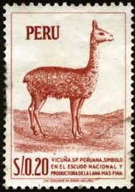
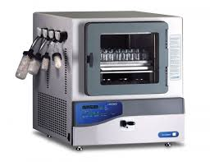
Peru
Origins of freeze-dried foods go back to the Incas of Peru.
Freeze-drying is a dehydration process typically used to preserve a perishable material or make the material more convenient for transport. Freeze-drying works by freezing the material and then reducing the surrounding pressure to allow the frozen water in the material to sublimate directly from the solid phase to the gas phase.
https://en.wikipedia.org/wiki/Freeze-drying

Slide 19
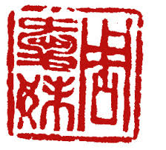
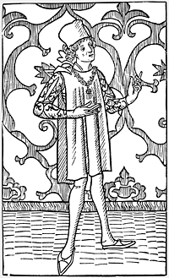
China
Marco Polo traveled to China during the 1200s to obtain spices and explore new trade routes.
He was 17 years old when he set out with his father for China and 38 when he embarked to sail home to Venice.
Marco Polo was not the first European to reach China (see Europeans in Medieval China), but he was the first to leave a detailed chronicle of his experience. This book inspired Christopher Columbus and many other travellers.
https://en.wikipedia.org/wiki/Marco_Polo
http://archive.aramcoworld.com/issue/200504/the.explorer.marco.polo.htm

Slide 20
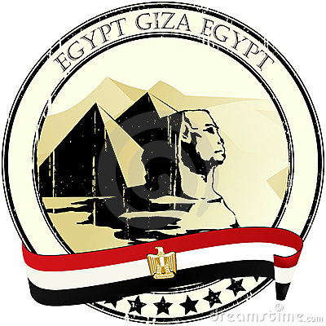
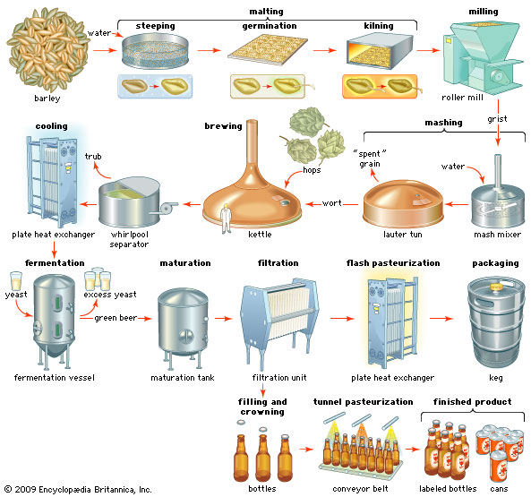
Egypt
As early as 3400 BC, Egyptians were placing a tax on beer produced in the ancient city of Memphis.
The basic ingredients of beer are water and a fermentable starch source such as malted barley. Most beer is fermented with a brewer's yeast and flavoured with hops. Less widely used starch sources include millet, sorghum and cassava. Secondary sources (adjuncts), such as maize (corn), rice, or sugar, may also be used, sometimes to reduce cost, or to add a feature, such as adding wheat to aid in retaining the foamy head of the beer.
https://en.wikipedia.org/wiki/Brewing

Slide 21
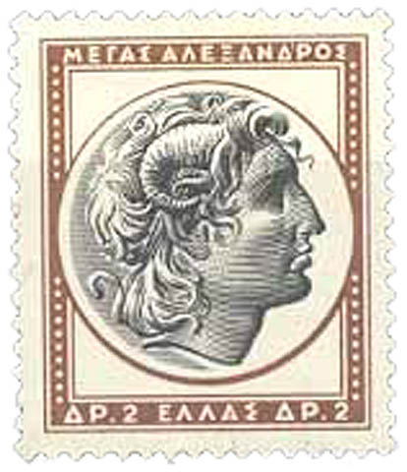
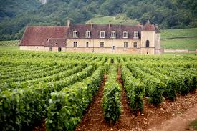
Greece
Thee Greeks established the first notable vineyards in regions bordering the mediterranean Sea.

