Slide 1
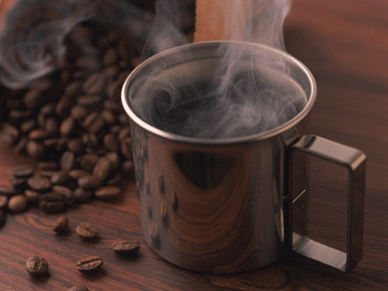
Bites Without Borders
A CLOSER LOOK ON COFFEE

Slide 2
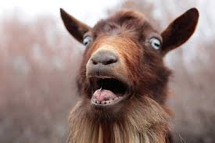
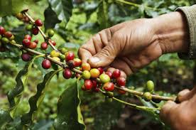
Origins of Coffee
It is believed that coffee was first discovered by an Ethiopian goat herder named Kaldi, who realized that one of his goats, upon eating coffee berries, became overly energetic. Excited about this discovery, he informed the abbot of the local monastery. The abbot was able to confirm Kaldi’s findings after making a drink out of the berries and finding himself feeling very alert and awake for long hours.

Slide 3
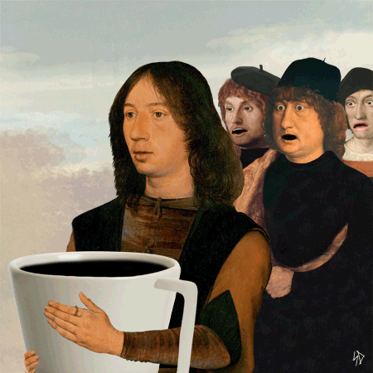
Origins of Coffee
Once word got out about the stimulating effects of these coffee berries, it rapidly spread across the globe to the Arabian peninsula, where the first coffee cultivation and trade began. By the 17th century, coffee gained global popularity, even replacing beer and wine as the new breakfast drink.

Slide 4
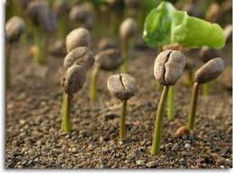
10 STEPS to make coffee
1. Plant the coffee seeds
-Make sure to plant them during the wet season in shaded nurseries. Water frequently.

Slide 5
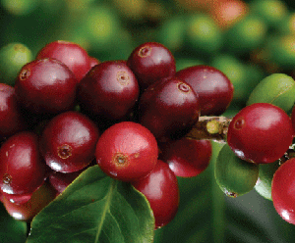
10 STEPS to make coffee
2. Harvest the cherries
-Cherries usually start appearing 3-4 years after planting the seeds. They become a bright red color once they are ripe. Berries can be collected by hand or through the use of machines. Usually, a good picker is able to collect enough coffee cherries to produce 20-40 pounds of coffee beans per day!

Slide 6
10 STEPS to make coffee
3. Process the cherries
-If picked by hand, cherries must be processed as soon as possible, in order to prevent spoilage.
-The dry method involved drying the berries out in the sun for a few weeks while the wet method requires a more complex procedure. The berries are first separated into skin and pulp, and then by size and weight, through the use of water channels and rotating drums. Finally, they are transferred to fermentation tanks, where they will stay for 12-48 hours.

Slide 7
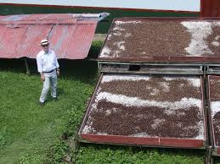
10 STEPS to make coffee
4. Dry the beans
-If the wet method was used for the previous step, the pulped and fermented beans now have to be dried to 11% moisture for storage.
-They can either be sun-dried or machine-dried in large tumblers.
-The dried beans at this stage are called ‘parchment coffee’.

Slide 8
10 STEPS to make coffee
5. Mill the beans
-The parchment coffee is processed through hulling, polishing, and grading and sorting.
-Hulling machinery allows the removal of the parchment skin from the wet, processed coffee.
-Polishing is optional and allows removing any skin that was left after hulling.
-Grading and sorting allows coffee beans to be sorted by size, weight, and color so that the defective beans can be identified and removed.

Slide 9
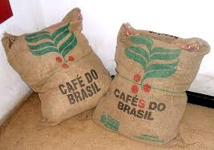
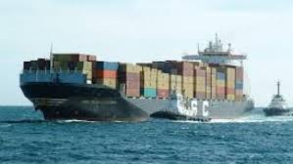
10 STEPS to make coffee
6. Export the beans
-The milled beans (now called ‘green coffee’) are loaded onto ships jute or sisal bags, or bulk-shipped inside plastic-lined containers.

Slide 10
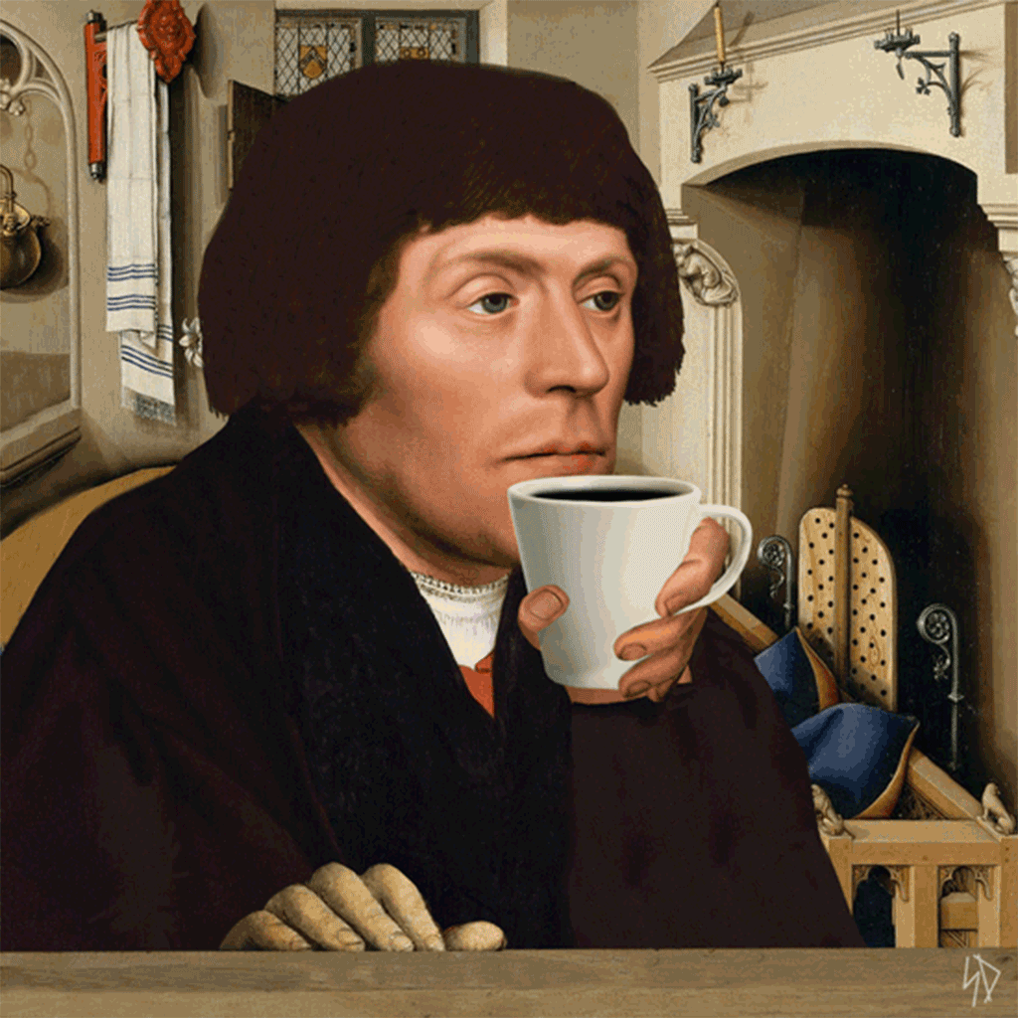
10 STEPS to make coffee
7. Taste the coffee
-Known as the cupper, a taster evaluates the coffee beans for visual qualities. After the beans are roasted and infused, the taster also evaluates the aroma and taste of the coffee through nosing it and slurping it with a quick inhalation, respectively.

Slide 11
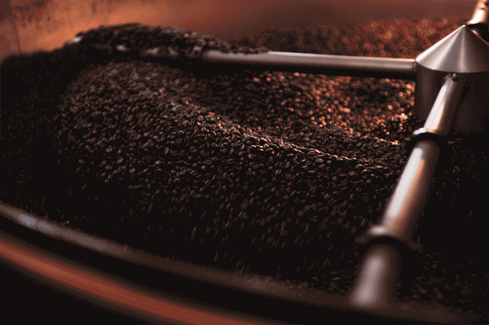
10 STEPS to make coffee
8. Roast the coffee
-Most roasting machines keep the beans moving at a temperature around 550 degrees Fahrenheit. Once the internal temperature hits 400 degrees Fahrenheit, the coffee beans gain their prized aroma and flavor through a process called pyrolysis, which allows the fragrant oil locked inside the beans to come out.
-After roasting, the beans are cooled by air or water.

Slide 12
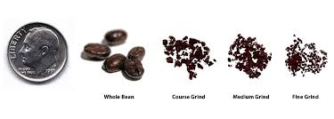
10 STEPS to make coffee
9. Grind the coffee
-Before brewing the coffee, it must be ground through the use of blade, burr, conical burr, or hand grinders.
-The various types of grinds include coarse, medium, fine, and pulverized.

Slide 13

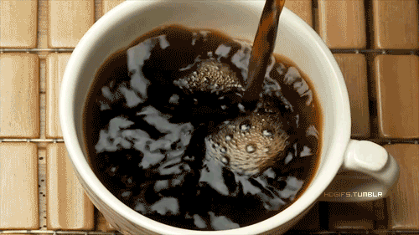
10 STEPS to make coffee
10. Brewing the coffee
-The reason behind this step is to extract the essential solubles like flavor compounds, soils, and oils from the coffee particles by exposing them to hot water.
-The ideal brewing temperature should be between 195-205 degrees Fahrenheit.
-A guideline for the coffee-to-water ratio is 2 tablespoons of coffee for every six ounces of water.

Slide 14
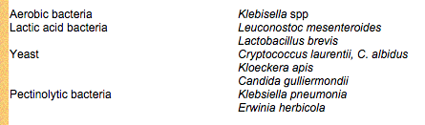
What happens inside the fermentation tanks?
After the removal of their skin (exocarp) and pulp (outer mesocarp), the coffee beans are put into fermentation tanks so that their hygroscopic mucilaginous layer (inner mesocarp) can also be removed through natural fermentation. This layer presents an obstacle to the subsequent drying and therefore needs to be degraded. Microbes that are involved in coffee fermentation include those listen below:

Slide 15
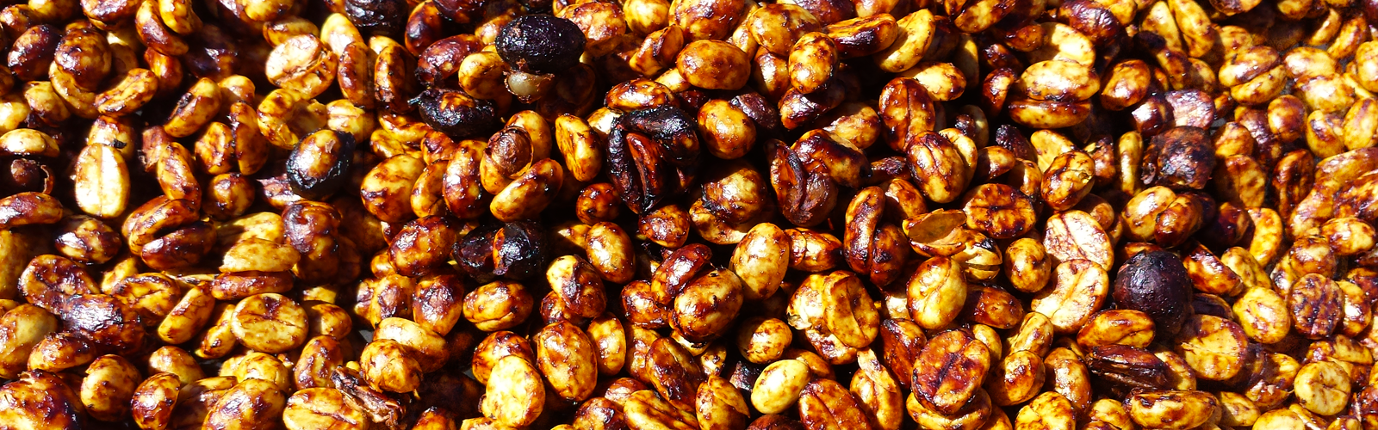
What happens inside the fermentation tanks?
Since the mucilaginous layer is primarily made up of simple sugars and pectin, the yeasts and bacteria are able to break it down by digesting the sugars. One of the main products of this process are acids, which help enhance the flavor and aroma of and add complexity to coffee.

Slide 16
Coffee around the globe
Since weather, amount of rainfall and sunshine, soil quality, altitude, and the processing procedures all affect the taste and aroma of coffee, there are many distinctions between coffees around the globe. For instance, a certain type of Mexican coffee known as Altura, is grown at very high altitudes. Puerto Rican coffee is known for its fruity aroma while Guatemalan coffee has a spicy or chocolatey taste. Indonesian coffee is famous for its rich body and mild acidity.

Slide 17
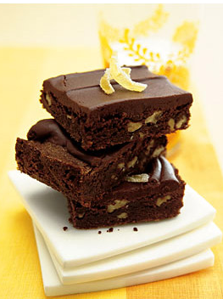
Cooking with Coffee:
A tasty recipe
Jamaican Coffee Brownies with pecans

Slide 18
Works Cited
http://www.ncausa.org/
http://www.gocoffeego.com/professor-peaberry/brewing-tips/coffee-grinding
http://link.springer.com/article/10.1007/s002840110213
http://www.darkmattercoffee.com/pages/fermentation
http://www.epicurious.com/recipes/food/views/Jamaican-Coffee-Brownies-with-Pecans-234819

